Slide 1
Deep Dive into Cluster Manager in 4.0

Slide 2
Cluster Manager
What is this “Cluster Manager” of which you speak?

Slide 3
First: We Need a Cluster!
Ethernet
machine 1
machine 2
machine 3
Notes:
Key points:
Collection of machines with a connecting communication bus (ethernet)
<zoom: CLUSTER>
Hey – what’s this that’s just shown up on the right hand side of the screen?

Slide 4
The “Depth Gauge”
cluster
The “depth gauge” indicates the current zoom-level as we dive into Cluster Manager
node
os process
erlang process
Notes:
Depth guage - indicates the zoom level as we dive into cluster manager. Will be present on each slide to show you how far down we’ve gone.
We are going to bring you down inside Erlang

Slide 5
The “Depth Gauge”
cluster
node
os process
erlang process

Slide 6
Back to the Cluster
Ethernet
machine 1
machine 2
machine 3
Couchbase Node
Couchbase Node
Couchbase Node
Notes:
The “cluster” to be a collection of machines on which the Couchbase Server is installed and the processes started up.
Each machine is called a “node”.
This cluster of nodes is the database server.

Slide 7
Back to the Cluster
Ethernet
machine 1
machine 2
machine 3
Couchbase Node
Couchbase Node
Couchbase Node
Notes:
These nodes are connected and talk to each other over TCP.

Slide 8
Back to the Cluster
This is the Cluster Manager
Ethernet
machine 1
machine 2
machine 3
node 1
node 2
node 3
Notes:
In each node there are a collection of collaborating OS processes.
The cluster manager is the processes that manage individual and collaborate with the other nodes to cause the system to behave as a clustered, intelligently managed database.
This is the “cluster manager”

Slide 9
What Does the Cluster Manager Do?
manage services
manage data topology
manage replications
provide metadata service
auth / security
REST API
UI
stats, monitoring, simple alerting
Notes:
You might ask: what does the cluster manager do?
Well: lots of stuff!

Slide 10
Anatomy of a Node
machine 1
babysitter
ns-server
memcached
indexer
query
xdcr
view -engine
other …
Notes:
Note that we have dropped down one rung on our depth gauge.
Now: we are inside a single node. Unit of the cluster.
Each of these boxes is a separate OS process.
Highlight the part that is the cluster manager: babysitter + ns-server
Babysitter will restart upon failure.

Slide 11
Anatomy of a Node
The Cluster Manager is babysitter and ns-server
machine 1
babysitter
ns-server
memcached
indexer
query
xdcr
view -engine
other …
Notes:
This is the cluster manager.
The babysitter process and the ns-server process.
Babysitter manages the processes on this node and ns-server coordinates all activities on this node and communicates with remote nodes.

Slide 12
Anatomy of a Node
Memcached serves key-value memcached requests & is deployed on “data service” nodes
machine 1
babysitter
ns-server
memcached
Notes:
Let’s look at the other OS processes in the node.
Memcached serves k-v requests and is deployed on data-service nodes.

Slide 13
Anatomy of a Node
XDCR, view-engine and some other services also deployed on “data nodes”
machine 1
babysitter
ns-server
memcached
xdcr
view -engine
other …

Slide 14
Anatomy of a Node
XDCR and view-engine were previously part of ns-server. They’ve been carved out for improved robustness
machine 1
babysitter
ns-server
memcached
xdcr
view -engine
other …
Notes:
New in 4.0: xdcr and view-engine were previously part of ns-server & have been carved out.

Slide 15
Anatomy of a Node
Indexer is deployed on nodes with the “indexing service”
machine 1
babysitter
ns-server
memcached
indexer
xdcr
view -engine
other …
Notes:
As the name implies the indexer process indexes DCP streams from memcached nodes. Deployed on nodes with the “index service.”
Talk by John yesterday gave us some great insight into the what goes on in the indexer

Slide 16
Anatomy of a Node
Query is deployed on “query nodes” and serves N1QL requests
machine 1
babysitter
ns-server
memcached
indexer
query
xdcr
view -engine
other …
Notes:
Query process is deployed on nodes with the “query service” enabled. Keshav covered this.

Slide 17

Inside ns-server
REST admin
master-only services
per-node-&-bucket services
per-node-&-bucket services
per-node services
generic distributed facilities
config gossip replication
distributed node discovery
generic local facilities
local config store
logging (ALE)
vclock, uuid, work queue, events, misc
Notes:
That was a bit about babysitter. Now we move to ns_server.
Note we’ve dropped down another level on the depth gauge.
What’s inside? Well let’s take a quick look at the subsystems in the ns-server.
This is fine but we want to get to the next level.

Slide 18

A Little Bit About Erlang
Developed in the 80’s for use in switches
Such as this – the famous AXD 301 switch which boasted ridiculous reliability
(Even allowing for hyperbole, it was pretty reliable)
Notes:
To do that we need to talk a little about Erlang.

Slide 19

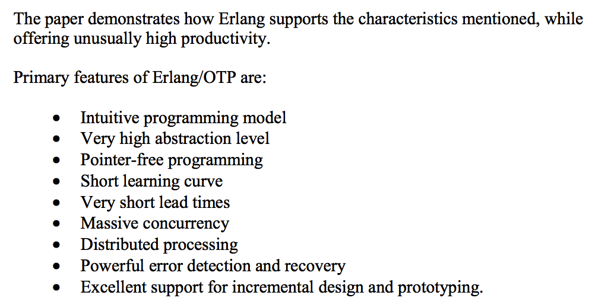
What Cool About Erlang?
According to Four-fold Increase in Productivity and Quality— Industrial-Strength Functional Programming
in Telecom-Class Products, http://www.erlang.se/publications/Ulf_Wiger.pdf

Slide 20
Key Feature of Erlang #1: Processes & Messages
Active, “lightweight processes”
Supports “actor model” style of programming
process
Processes have a mailbox for incoming messages
Notes:
In my view, one of the key features of Erlang are: lightweight processes and messages.
AKA “actor model”
Asynchronous, distributed, single assignment

Slide 21
Key Feature of Erlang #1: Processes & Messages
P ! x,
P ! y,
P ! z.
process P
process Q
z
y
x
Values are immutable (no shared state)
Communication asynchronous

Slide 22
Key Feature of Erlang #1: Processes & Messages
receive y ->
Q ! a
end.
process P
process Q
a
x
y
z
“Selective receive”
Notes:
AKA “actor model”
Asynchronous, distributed, single assignment

Slide 23
Key Feature of Erlang #1: Processes & Messages
a
process P
process Q
x
z
Notes:
One of the nice things about Erlang is that message passing feels the same and has the same semantics within a process and across processes that are part of the Erlang distributed system.

Slide 24
Key Feature of Erlang #1: Processes & Messages
a
process P
process Q
b
x
z

Slide 25
Key Feature of Erlang #2: OTP
Framework that provides useful higher-level constructs built from Erlang primitives
process
gen_server
1
2
1
Such as gen_server, a generic, stateful, startable and stoppable server
Notes:
Second key feature, in my view is OTP – which stands for “Open Telecom Platform” – but really is a framework that provides useful higher-level constructs built from Erlang primitives.

Slide 26
Key Feature of Erlang #2: OTP
Also such as supervisor, a process responsible for starting, restarting, stopping and monitoring its child processes
supervisor
gen_server 1
gen_server 2
gen_server 3
Notes:
And supervision hierarchies.
Erlang processes and supervisor form a little ecosystem, like people working in a factory

Slide 27
Inside ns-server
The ns_server ‘application’.
Applications describe the bundle of code that is started and stopped together.
ns_server
Notes:
Now we have the vocabulary to explore inside ns_server – which is the heart of the cluster manager.
Instantiated via the ns_server application.

Slide 28
Inside ns-server
ns_server
ns_server_cluster_sup
The application is responsible for starting the top level supervisor: ns_server_cluster_sup
Supervises all supervisors and by extension all Erlang processes in ns_server
Notes:
supervises all the supervisors

Slide 29
Inside ns-server
ns_server
ns_server_cluster_sup
ns_config_sup
ns_server_nodes_sup
ns_cluster
other services
…
Everything related to managing config: e.g. storing, updating change notifications
Main supervisor for the node outside of config mgmt
Performs node join / leave requests
Other stuff we won’t focus on today
Notes:
main thing to notice here is the ns_server_nodes_sup – which is the main part of the supervision hierarchy

Slide 30
Inside ns-server
ns_server
ns_server_cluster_sup
ns_config_sup
ns_server_nodes_sup
ns_cluster
other services
…
Controls main part of supervision hierarchy
ns_server_sup
other services
…

Slide 31
Inside ns-server
ns_server
ns_server_cluster_sup
ns_config_sup
ns_server_nodes_sup
ns_cluster
other services
…
ns_server_sup
other services
…

Slide 32
Inside ns-server
Responsible for master election
ns_server_sup
mb_master
ns_node_disco_sup
menelaus_sup
mb_master_sup
Node discovery supervisor
Supervisor for REST API and web UI app server
ns_orchestrator
Notes:
master election – key part of the distributed system; is highly available; coordinates all cluster-wide activities
starts the system-wide orchestrator

Slide 33
Inside ns-server
ns_server_sup
ns_bucket_sup
other
processes

Slide 34
Inside ns-server
ns_bucket_sup
single_bucket_kv_sup
other
processes
ns_memcached_sup
ns_memcached mediates communication with memcached process and tracks its health
ns_memcached
Notes:
this is the bucket manager; takes care of your bucket on this node for you

Slide 35
Inside ns-server
ns_bucket_sup
single_bucket_kv_sup
other
processes
ns_memcached_sup
replication
manager
dcp_sup
dcp_sup and the replicators manage inbound (consumer) DCP replication streams
ns_memcached
dcp_replicator
-node1
dcp_replicator
-node2
Notes:
dcp_sup – manages DCP replication streams inbound to this node

Slide 36
Inside ns-server
The janitor agent keeps things nice and clean and provides remote communication façade for bucket management
ns_bucket_sup
single_bucket_kv_sup
other
processes
ns_memcached_sup
replication
manager
dcp_sup
janitor_agent_sup
ns_memcached
dcp_replicator
-node1
dcp_replicator
-node2
janitor
agent
Notes:
janitor_agent

Slide 37
NS-Server in Action: Rebalance
node
master node
rebalance
idle
rebalancing
menelaus_web
ns_orchestrator
ns_rebalancer
rebalancing
User clicks “Rebalance” button
State -> “rebalancing”
Orchestrator starts rebalancer
Notes:
ns-server in action

Slide 38
NS-Server in Action: Rebalance
master node
ns_rebalancer
ns_bucket_mover
ns_single_vbucket_mover
1
ns_single_vbucket_mover
2
Rebalance computes new vbucket map & starts the bucket mover
Bucket mover in turn starts single vbucket movers
Notes:
<zoom out: show cluster again with communication connecting ns-servers>
<zoom: CLUSTER>
Master election (leader election)
Key – elect a leader or master. Master coordinates almost all cluster-wide functions.
Show the mb_master process in each of the nodes

Slide 39
NS-Server in Action: Rebalance
master node
ns_single_vbucket
mover
begin
janitor
agent
dcp_sup
memcached
to-node
dcp_replicator
to-node for
vbucket
Single vbucket mover sends request to new node to begin replicating
janitor
agent
memcached
from-node
from-node for
vbucket
Notes:
<zoom out: show cluster again with communication connecting ns-servers>
<zoom: CLUSTER>
Master election (leader election)
Key – elect a leader or master. Master coordinates almost all cluster-wide functions.
Show the mb_master process in each of the nodes

Slide 40
NS-Server in Action: Rebalance
master node
ns_single_vbucket
mover
janitor
agent
dcp_sup
memcached
to-node
wait
dcp_replicator
to-node for
vbucket
Then mover waits until the backfill is done and replication is up-to-date
janitor
agent
memcached
from-node
from-node for
vbucket
Notes:
<zoom out: show cluster again with communication connecting ns-servers>
<zoom: CLUSTER>
Master election (leader election)
Key – elect a leader or master. Master coordinates almost all cluster-wide functions.
Show the mb_master process in each of the nodes

Slide 41
NS-Server in Action: Rebalance
master node
ns_single_vbucket
mover
janitor
agent
dcp_sup
memcached
to-node
takeover
dcp_replicator
to-node for
vbucket
Lastly mover converts the backfill replication stream to a “takeover” stream
janitor
agent
memcached
from-node
from-node for
vbucket

Slide 42
Inside ns-server
REST admin
master-only services
per-node-&-bucket services
per-node-&-bucket services
per-node services
generic distributed facilities
config gossip replication
distributed node discovery
generic local facilities
local config store
logging (ALE)
vclock, uuid, work queue, events, misc
Notes:
<zoom in to ns-server>
<diagram: large-scale structure of ns-server, showing different subsystems>
<zoom: OS_PROCESS>
Large scale structure of ns_server.
Similar / identical to Steve’s slide.
Composed of different subsystems:
libraries
master services
per node services
per node – per bucket services
generic services
events
To zoom in further, we need to talk a little about the language. Erlang.

Slide 43
Anatomy of a Node
machine 1
babysitter
ns-server
memcached
indexer
query
xdcr
view -engine
other …

Slide 44
Back to the Cluster
Ethernet
machine 1
machine 2
machine 3
node 1
node 2
node 3

Slide 45
Get Started Today Couchbase Server 4.0 & N1QL couchbase.com

